Slide 1
QOLOQUIO REJOLUSAUN KONFLIKTU
CONFLICT RESOLUTION WORKSHOP
DR RUTH RUDGE
DR JOHN RUDGE
DILI, 20 DE NOVEMBER DE 2014

Slide 2
We want to acknowledge the conflict in Timor Leste as background to today’s workshop
And that the effect that conflict has had on individuals and organizations in Timor Leste is great.

Slide 3
Timor-Leste nia historia nakonu ho konflitus barak.
Komesa ho repatriasaun etniku neébé tuir mai kolonialismu Portuguese nian besik tinan 400 neébé iha relasaun ho konfliktu, neébé parte populasaun sempre fahe malu forsa estrangeiru nian, Historia neé sei akontese tan iha funu mundial daruak. Hamutuk, funu civil iha 1975 no okupasaun husi Indonesia tinan 24 nia laran (inklui eventu 1975 nn 1999) kauza ema 100,000 mak mate, asociasaun ho massacre no estraga, intrega Timor-Leste sai sociedade nakonu ho traumatika. Divisaun klean no falta kohesaun nasional hanesan resulta klaro, hamutuk ho konfliktu pesoal no la hetan fiar.
OXFORD INSTITUTE FOR ETHICS, LAW, AND ARMED CONFLICT 2012

Slide 4
Ita agora atu apresenta dalan pratika neébé ita bele halo asaun dame
Dahuluk ita sei koalia kona-ba VALOR iha rejolusaun konfliktu
Saida mak valor?
We are going to present on practical ways we can act peacefully
First we will talk about VALUES in conflict resolution
What are values?

Slide 5
Valor mak saida buat neébé klean liu iha ita nia fuan laran neébé ita moris hakarak lao tuir ba.
Valor mak saida mak ita hakarak atu luta ba
Valor mak saida fiar liu ba
Valor hanesan kompasu neébé fo ita dalan moris nian
Valor ida neé laos alvu
Alvu mak saida mak ita bele atinji no remata
Valor neé buat neébé boót liu
Values are the things deep in your heart that you want your life to be about.
Values are what you want to stand for
Values are what truly matter to you
Values are like a compass that give our lives direction
A value is not a goal
Goals are something we achieve and finish
A value is much bigger

Slide 6
Ezemplu
Dalaruma hau nia valor mak neé ona
Hodi hetan moris dame liu no trata ema ho laran mamar ida neé mak valor ida
Valor hau nia mak dalaruma sai parenti neébé diak
Ita bele hetan oan. Ida neé alvu
Sai hanesan parenti neébé diak sei ba nafatin
Neébé sai parenti diak hanesan valor ida
For example
I might have a value
To live life peacefully and to treat people kindly
This is a value
I might value being a good parent
You can have a child. That is a goal.
Being a good parent goes on forever
So being a good parent is a value

Slide 7
LISTA VALORSERVISU
Pergunta
Ita nia valor saida neébé iha relasaun ho konfliktu?
Grupo diskusaun kiík
Hatoó fali ita boót sira nia relatoriu
Oinsa ita uza ita nia valor hodi ajuda ita atu halo asaun dame?
WORKSHEET VALUES
Question
What are your values regarding conflict?
Small group discussion
Then report back
How do we use our values to help us with acting peacefully?

Slide 8
TERAPIA ASEITASAUN NO KOMITMENTU– ACT (ACCEPTANCE AND COMMITMENT THERAPY)
Mota no mota ninin – dalan atu hakat sai husi ita nia hanoin no sentimentu no sai husi konfliktu no hare dalan klaro liu tan hodi responde ba situasaun ruma
Iha konfliktu laran – wainhira iha mota laran
ACCEPTANCE AND COMMITMENT THERAPY – ACT
The river and the river bank - a way of stepping out of our thoughts and feelings and out of conflict and seeing a wise way to deal with a situation
In conflict - is in the river

Slide 9
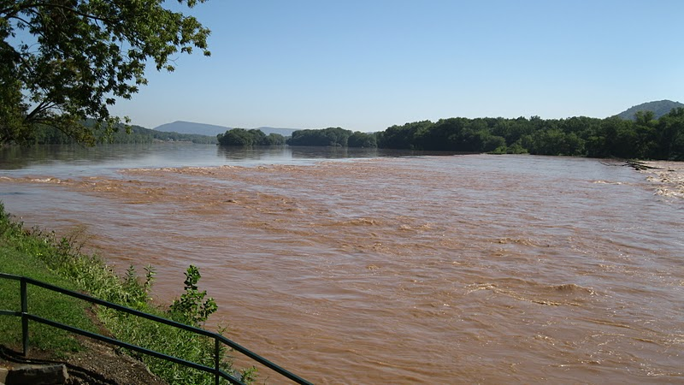
HAKAT SAI HUSI MOTA

Slide 10
Iha mota laran ita sei - mantein ho visaun ida deit, laiha hanoin flexibilidade, la hare visaun seluk, ita haluhan ita nia valor sira
In the river we are –
Stuck in a point of view,
Inflexible thinking,
Cannot see other points of view,
We have forgotten our values

Slide 11
Iha mota ninin neé iha ligasaun ho ita nia valor sira
Iha mota ninin ita livre
Ita la belit ona
Ita bele rona ema seluk nia visaun
Hakat sai husi mota ita bele hare sitausaun hotu
Asaun husi mota ninin ita bele hare klaro liu no ita bele hanoin ita nia valor.
Ida neé fo ita hodi bele hakat sai husi konfliktu no resolve konfliktu ho dame
On the river bank is connected to our values
On the river bank you are free
You are not stuck
You can hear the other persons point of view.
Stepping out of the river you can see the whole situation.
Acting from the river bank - we can see more clearly and so we can remember our values.
This allows us to step out of conflict and resolve conflict peacefully

Slide 12
Pergunta:
Oinsa ita foti asaun dame?
Oinsa ita hakat sai husi mota laran?
No asaun husi ita nia valor?
Question:
How do we act peacefully?
How do we get out of the river
And act from our values?

Slide 13
John sei hanorin ita excersisu hanoin principal sira
John will teach a mindfulness exercise

Slide 14
PERGUNTA
Oinsa ita hetan excersisu neé? PERGUNTA RUMA TAN?
How did you find that exercise? ANY QUESTIONS?

Slide 15
Isplikasaun ba exercisu grupo kiík
Hanoin ezemplu konfliktu ruma nebe ita iha ona no ita bele resolve/hakat sai husi konfliktu “mota”no sae ba mota ninin no kontaktu ho konfliktu husi imi nia valor
Fahe ba malu
Brief small group exercise
Think of an example of conflict you have been in and you were able to step out of the conflict ‘river’ and get on the river bank and deal with the conflict from the bank remembering your values
Sharing

Slide 16
Komprende situasaun
Sei hatene kona-ba konfliktu sira – ita bele halo ida neé uanhira ita iha mota ninin no sei hatene liu
Hau halo saida kona-ba situasaun konfliktu?
Iha situasaun neé hau halo tan saida?
Ita hotu hakarak atu muda mundu neé diak liu.
Ita hotu iha valor neébé inklui dame iha servisu fatin, dame iha nasaun, no dame prosperiadade iha familia laran.
Understanding the situation
Become clear about what the conflict is – we can do this when we are on the river bank and become wise
What can I do about the conflict situation?
Is this a situation I can do something about?
We all want to change the world for the better.
We may all have values that include a peaceful workplace, a peaceful country, and a peaceful prosperous family.

Slide 17
Jesus iha valor neé. Lider boót sira iha valor neé
Mateus 5.9 –
Graca wain ba sira neébé halo dame tamba sira ema sei bolu hanesan maromak nia oan
Jesus had these values. Many great leaders have had these values
Matthew 5.9 –
Blessed are the peacemakers for they shall be called the children of god

Slide 18
Excesicu hanoin principal
3 Espektakulu
Ka
Scan isin no sura

Slide 19
DR JOHN AND RUTH RUDGE
southerncrosspsychology@gmail.com
Suite 5 Level 2 82 Smith St Darwin
PO BOX 103 NIGHTCLIFF 0814
Darwin Office Telephone number: +61889815235
Timor Telephone Number 78619584
actmindfully.com.au –
WEBSITE – DR RUSS HARRIS

